Slide 1
My cable – the inside story
Mark Boxer
Applications Engineering Manager
OFS
Your Optical Fiber Solutions Partner®
All Rights Reserved, Copyright © OFS Fitel, LLC 2017

Slide 2
Agenda
Fiber property refresher
The cable protects the fiber
Cable anatomy
Primarily for electric coop and municipal builds
Trunk/distribution versus drop cables
Pros and cons of lashed versus ADSS cables and more detailed ADSS information

Slide 3
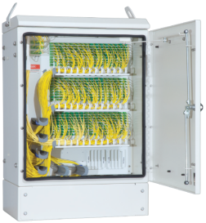
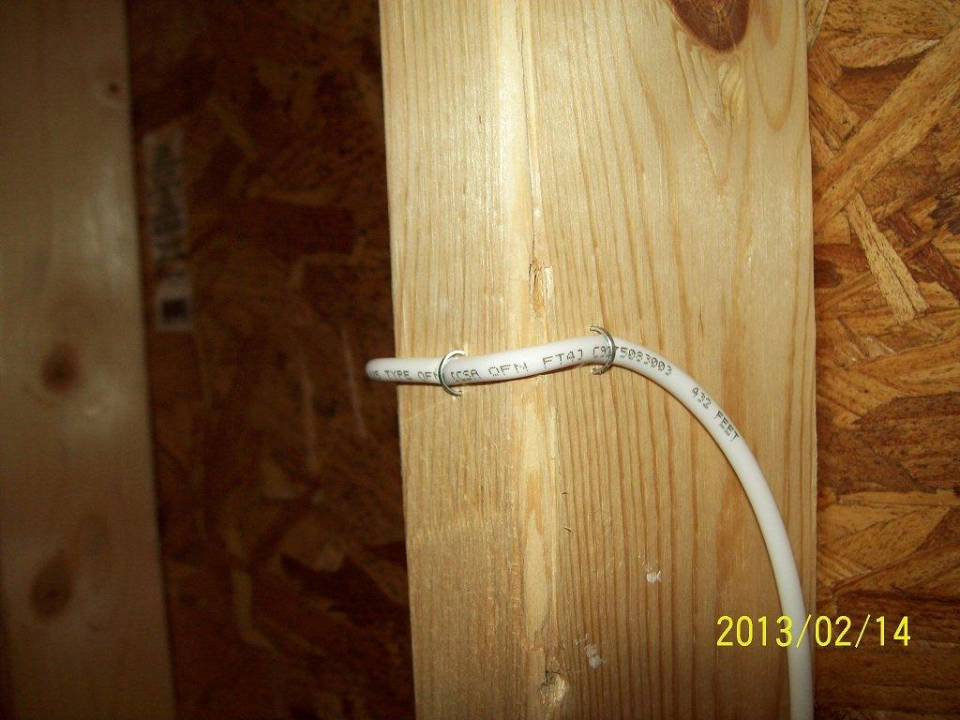
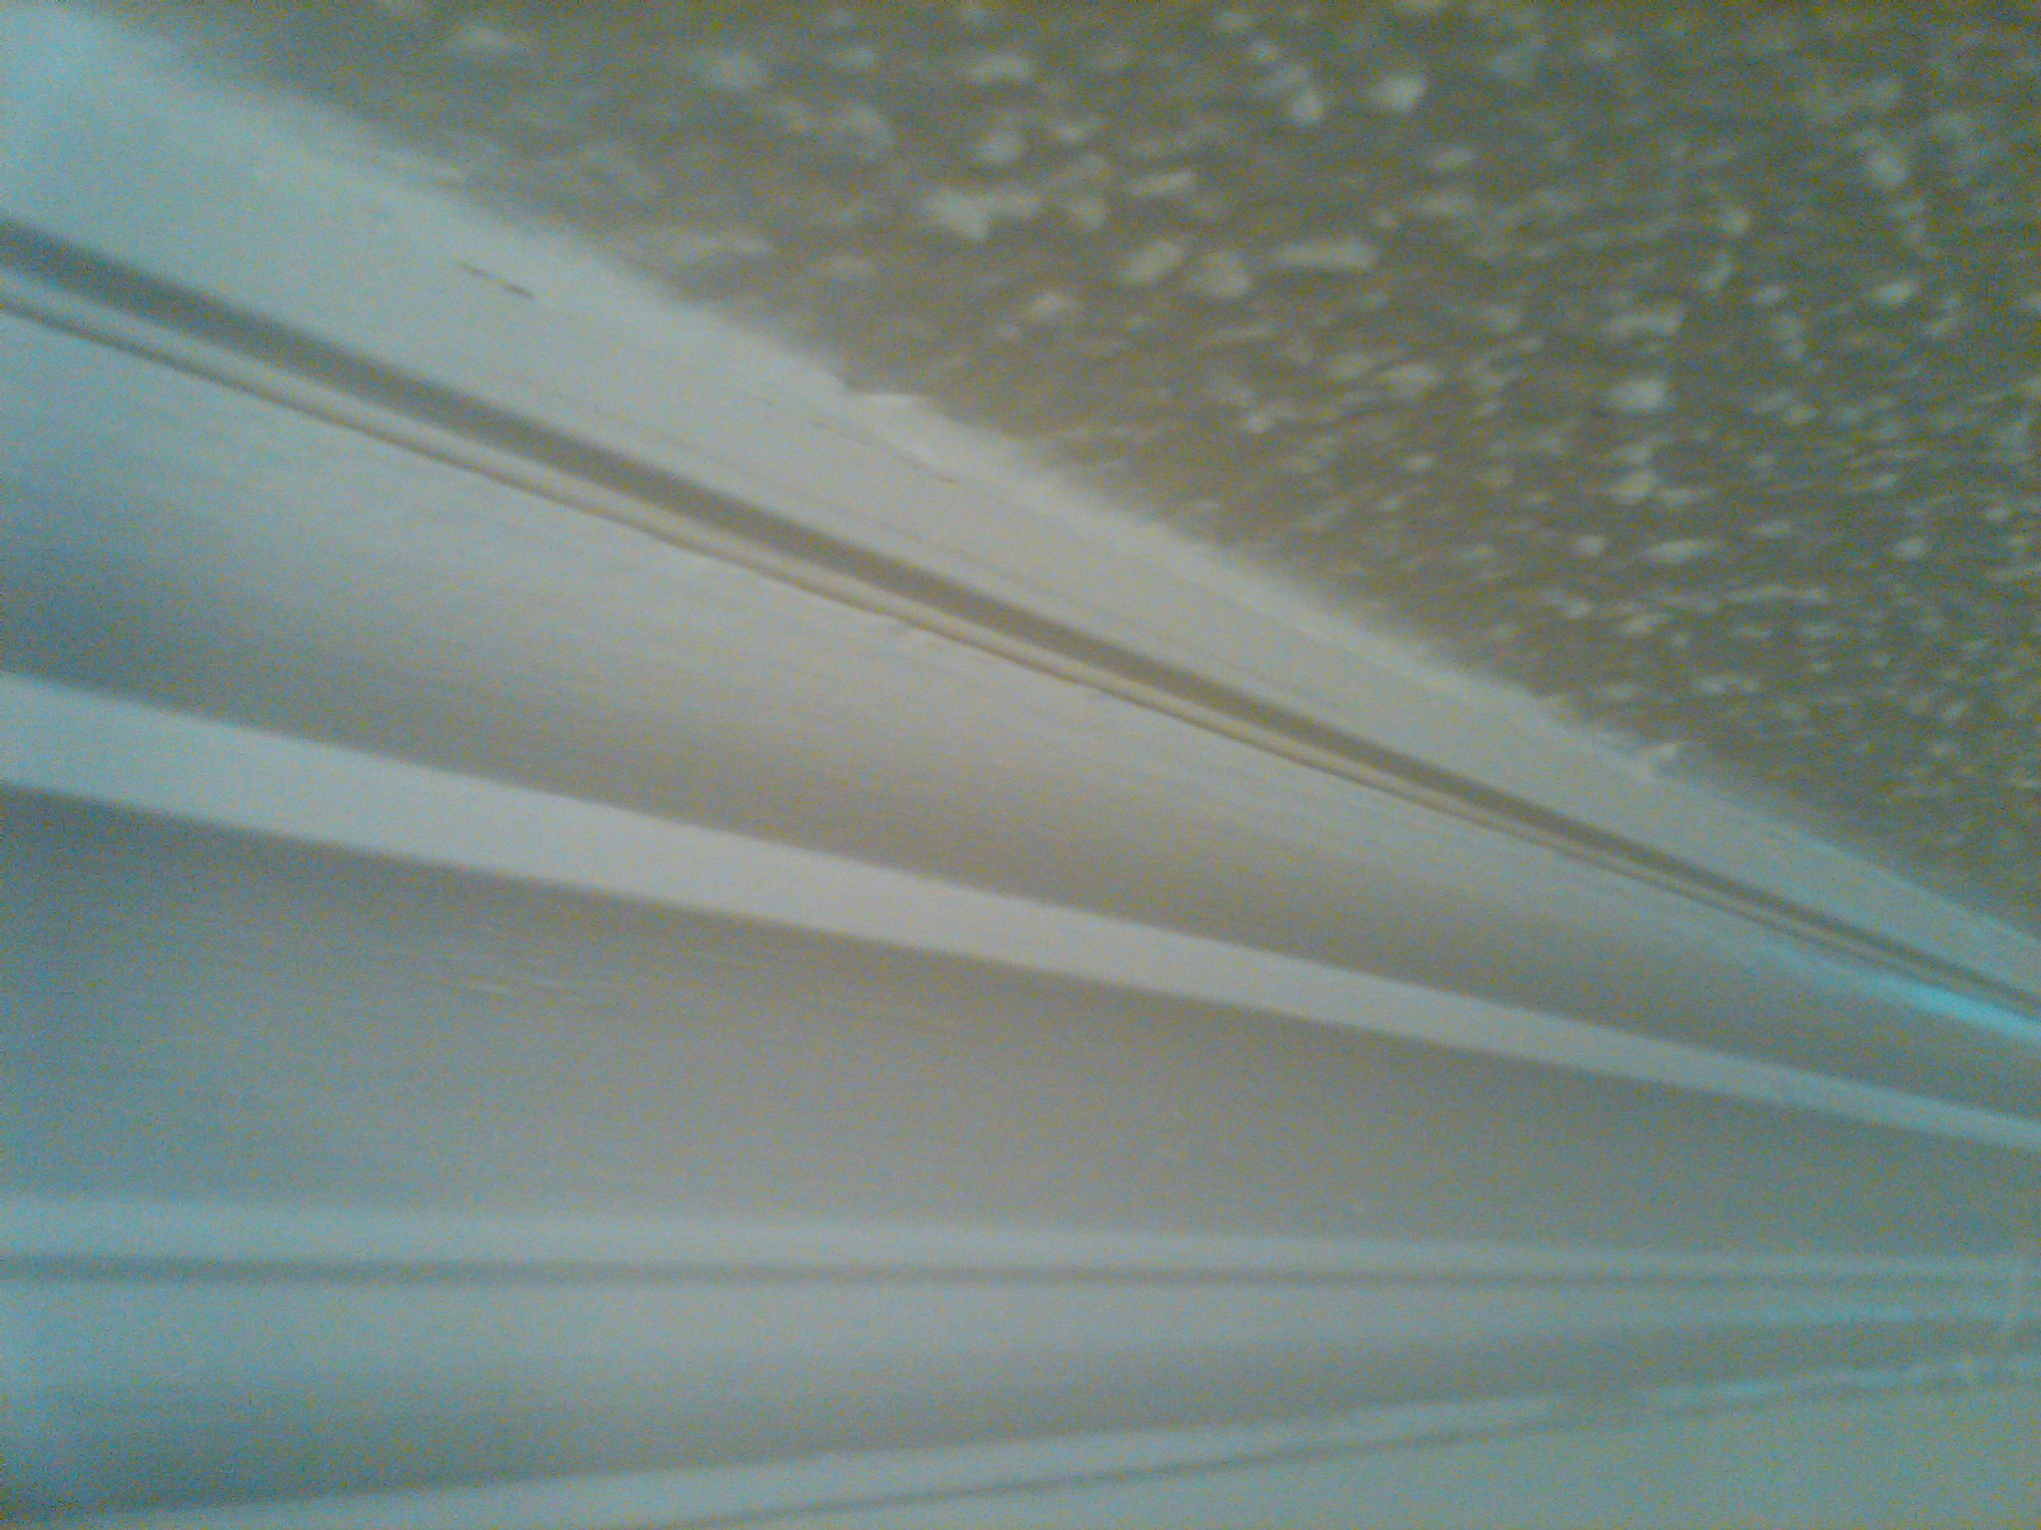
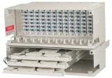
Different fiber types do different jobs
Cabinets, boxes,
closures
In homes and buildings
Network core and drops
G.652.D/G.657A1
G.652.D/G.657A2
G.657B3

Slide 4
ITU-T G.657 Bend Loss Insensitive SM Fiber
Minimum design radius | ITU-T G.657 Fiber Standard
10 mm Bend Challenged OSP Cable | G.657A1
7.5 mm Most Connectivity Applications | G.657A2
5.0 mm In Home/MDU Drop | G.657B3

Slide 5
Fiber strain
Limiting fiber strain drives all mechanical reliability calculations
< 0.2% long-term strain targeted for negligible crack growth
Higher allowable for short periods of time
Serves as cable tension limitation –
Maximum Rated Cable Load (for ADSS)
Max Installation Tension (for duct/underground cables)
Fiber has become well known for outstanding reliability – due to this limitation
Tension
< 0.2% strain

Slide 6
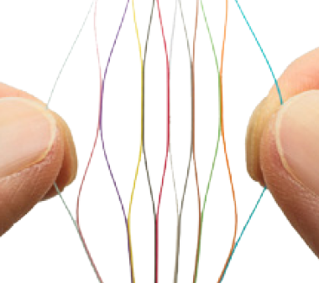
Outside Plant Cable Anatomy
Buffer tube
Fiber
Most often “loose tube” cable structure
Fibers loose in buffer tubes
Handles stress/strain and temperature fluctuations and climatic extremes
Also available in ribbons
Fibers and buffers are color coded
Underground applications
Direct Buried – typically armored
Duct cable
Aerial applications
Lashed to a messenger
Self-supporting (ADSS, All-Dielectric, Self-Supporting)
Loose buffer tube structure
Flat ribbon
Rollable ribbon

Slide 7
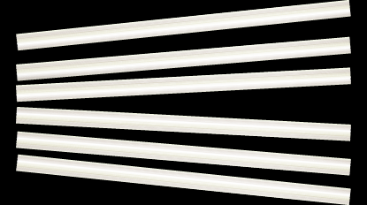
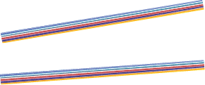
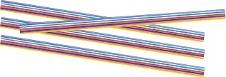
Outside Plant Cable Anatomy

Slide 8
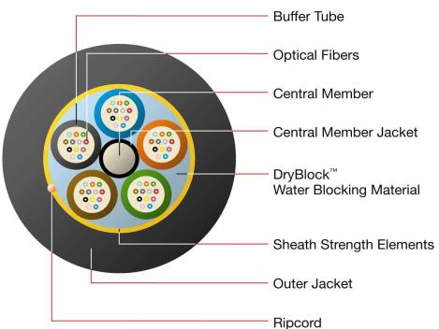
Outside Plant Cable Anatomy

Slide 9
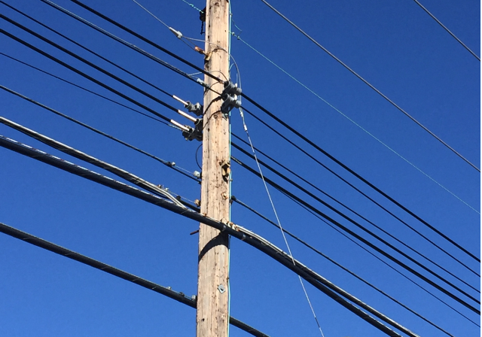
Differences between ADSS and Loose Tube Duct Cable Applications
ADSS
Lashed
Uses metallic strand to support cables
Used for legacy copper, coax cables
ADSS
Often used for new builds with no strand
Self-supporting cable
Lashed

Slide 10
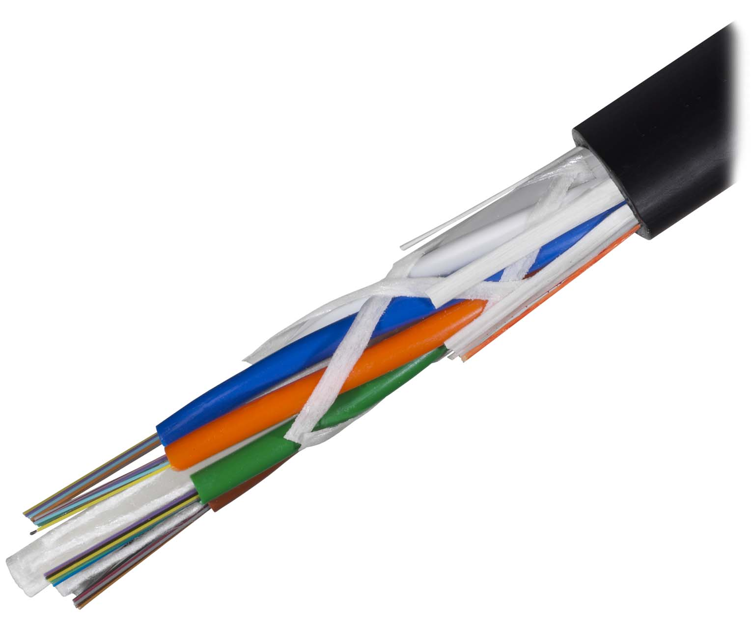
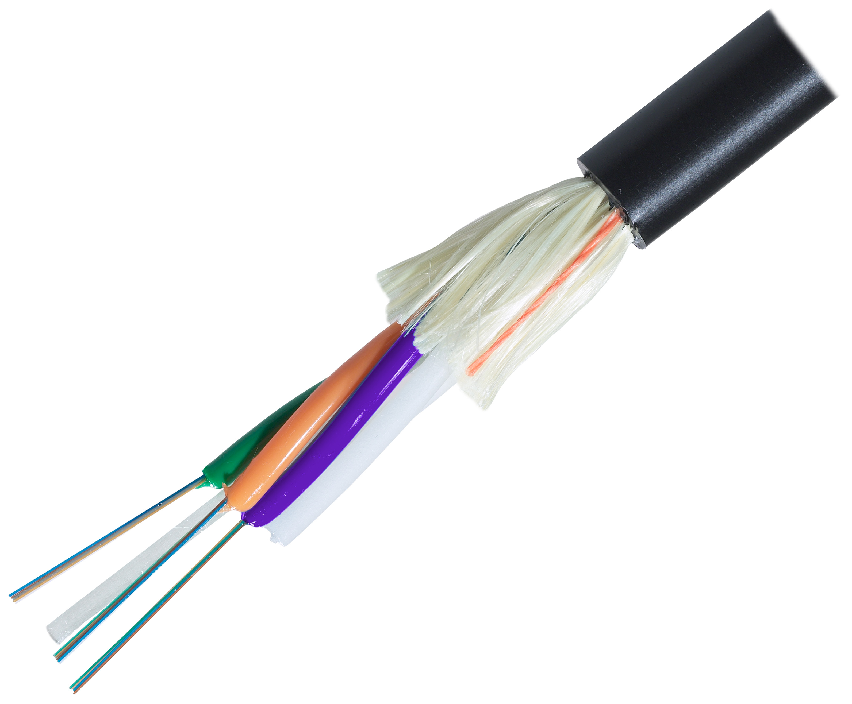
Differences between ADSS and Loose Tube Duct Cables
Loose tube duct cables, lashed to a messenger wire
Not self-supporting
Typical 600 pound pulling tension short term
Ice/wind load absorbed by the strand
More strain expected at installation
ADSS, (All-Dielectric, Self-Supporting)
Self-supporting – designed for span lengths and ice and wind loads
Least strain at installation
More strain upon loading – typically higher “MRCL” (Maximum rated cable load”

Slide 11
Differences between ADSS and Loose Tube Duct Cables
Competitor ADSS and standard loose tube
OFS ADSS tube
Tube thickness and free space are important
Tube wall thickness
Higher crush resistance
Free space and excess fiber length
Higher margin before fiber strain
Roughly to scale
More free space
Thicker wall
Not to scale

Slide 12
Differences between ADSS and Loose Tube Duct Cables
EFL (Excess Fiber Length)
Sometimes different between ADSS and loose tube cables
Balance is needed
More fiber enables more stretch before fiber strain
Too much fiber can induce attenuation issues
ADSS tube and EFL – not to scale
Loose tube duct cable tube and EFL – not to scale

Slide 13
Differences between ADSS and Loose Tube Duct Cables
Stranding angles are important
Steeper angles enable more stretch before fiber strain occurs
Uses more fiber
Stranding angle
Steeper angle
Shallower angle

Slide 14
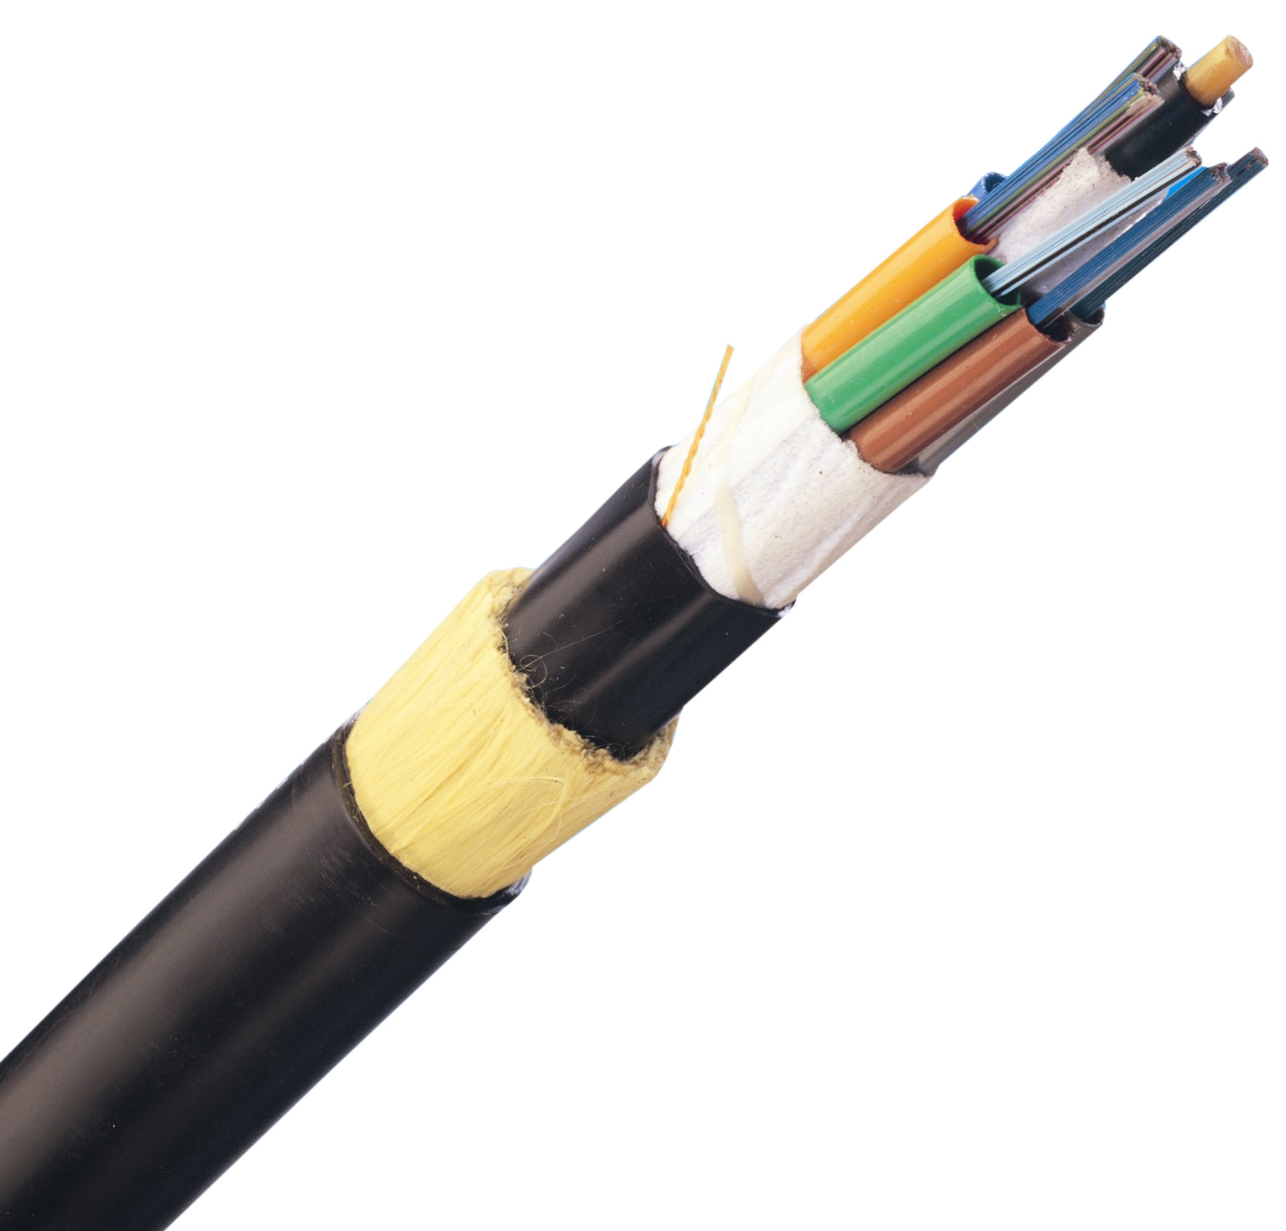
Differences between ADSS and Loose Tube Duct Cables
Amounts and types of strength member (fiberglass or aramid) are important to control stretch of the cable
Duct cables – Often use glass rovings
Short span ADSS cables – Often use aramid yarns for strength and to limit stretch
Long span ADSS cables – Often uses more aramid and 2 jackets

Slide 15
The importance of gel-free
Lighter
Lower tensions
Easier to use
Lower labor to prep

Slide 16
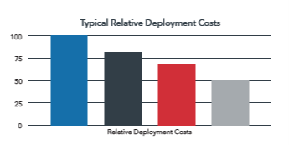
Cable choice depends on the application
ADSS
Lashed cable
Often better choice when going to new areas
Lower make-ready and installation costs
Less clean drop management
Often faster installation
Typically more expensive unless strand is available
Good choice for higher customer density areas and more ground clearance
Higher make-ready costs and slower initial deployment
Cleaner drop management
OFS expects long-term reliability for either cable type to be similar.
Solutions can be mixed and matched as needed.

Slide 17
Why ADSS for FTTH?
Fast and inexpensive installation
No need to lash
Lower tensions – possibly less guying
Little to no maintenance
No bonding or grounding
Can place in supply zone
Reduces make-ready
Often the best choice for FTTH when building to new areas

Slide 18
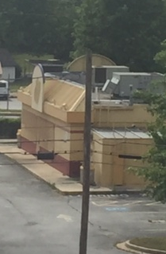
Where to use lashed cables
“No brainer” if a strand is already installed
Higher density areas (reduces pole attachments for drops)

Slide 19
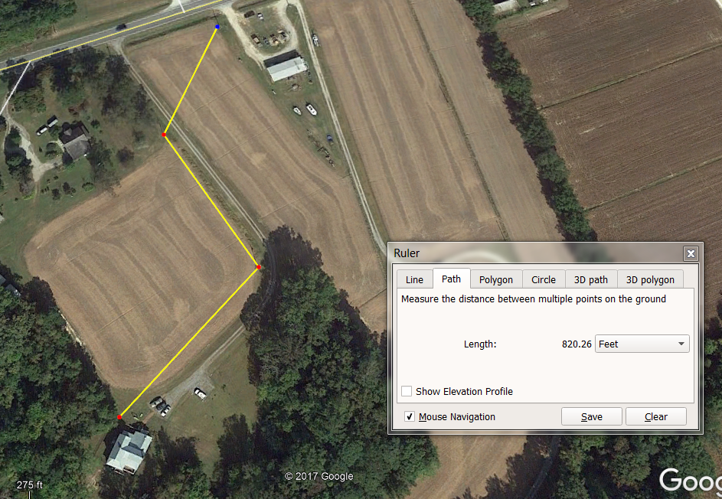
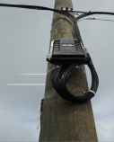
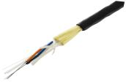
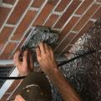
A typical ADSS network
PowerGuide ShortSpan DT and hardware
SlimBox Drop Terminal and splitter
PowerGuide TTH and hardware
SlimBox CSP and EZ Bend to the ONT

Slide 20
ADSS installed cost is typically significantly less expensive
Cable and installation costs for 50,000’ 24 fiber network
Installation typically significantly less expensive
Install 1 cable versus 2
Fewer trips up the pole
$0.20-$0.30/foot less expensive
Typically much faster
1-2 km/day are not unusual
Depends on Right of way
Lower tensions – possibly less guying
Assume roughly $0.08/foot
No maintenance
No bonding or grounding
Can place in supply zone
Reduces make-ready, up to $0.25/foot
The best choice for FTTH when building to new areas

Slide 21
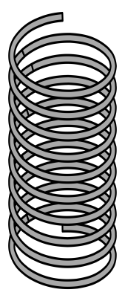
How does ADSS work?
x
Cable breaks
x
Fibers break
x
Max Rated Cable Load (MRCL)
x
x
Designed loading
σ (Stress)
Fiber strain begins
x
After installation
ɛ
(Strain)
S_{i}
S_{l}

Slide 22
Required Design Information
Fiber count
Worse case environmental loading conditions
Ice thickness (radial or rime), wind
Temperature, safety factors
Maximum span – not ruling span
Installation Sag Percent
Installation sag as a percent of the span. Assumed to be 1.5% if not specified.
Loaded sag % (if required)
Line voltage
span
S_{i}
S_{i} = sag initial (no load)
S_{l}
S_{l} = sag loaded
Loaded case shown exaggerated*

Slide 23
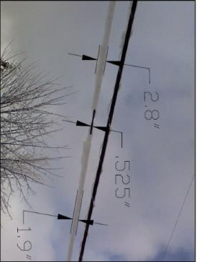
Ice and wind loading
Ice loading with ADSS
Round, typically no galloping
Ice loading with lashed or figure 8, Airplane wing shape Possible galloping

Slide 24
ADSS cable reliability – main components
Fiber
Following recommended installation tensions limits fiber strain
<0.2% strain corresponds to 1% crack growth
Corresponds to 40 year lifetime
No known upper lifetime limit
Aramid
No known fatigue mechanism similar to those in metals
All materials
Strain is limited to the “elastic” range of the curve, no plastic deformation
Inner/Outer polyethylene jacket
Bell Labs/OFS work on polyethylene began in 1947
Deep understanding of various reactions with UV, aging, etc
View from technical community
“We don’t know when jackets with 2.6% N110 black will degrade … they have not existed long enough for us to find out yet.”
“Current modern black PE jackets for aerial optical cable will almost certainly be fine long after we’re all dead.”

Slide 25
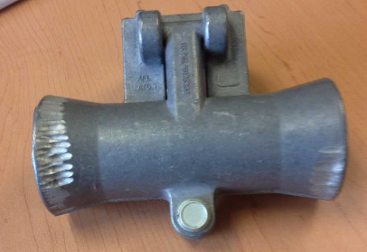
Squirrels – ADSS versus lashed armored cables
Cables need to last for decades
Squirrels will eat through either dielectric or armored cables
Armored cables may take a little longer, but will eventually also need to be replaced
Armored cables have their own concerns – specifically bonding/grounding, and lightning
OFS is familiar with various additives used for “squirrel resistance”.
We are skeptical of their long-term performance.
OFS’ position for coops
The best defense against squirrels is an effective tree-trimming program
The benefits of dielectric cables outweigh the limited additional time provided by using armored cables

Slide 26
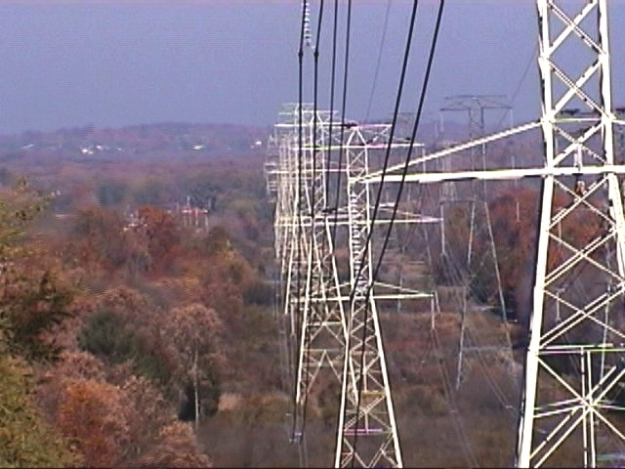
Other ADSS performance notes
ADSS has small coefficient of thermal expansion vs metal cables
ADSS has small creep vs metal cables

Slide 27
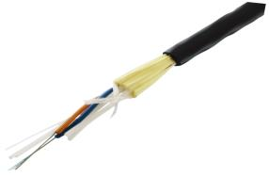
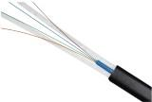
Typical OFS ADSS options
Main trunk cables and ultra-long drops
PowerGuide DT, Gel-Free ADSS
Lite tension formed wire deadends and tangent clamps
Branch and longer span drop cables
PowerGuide TTH “To the home”, 9.0 mm
Up to 300-400’ spans, dependent upon sag/tension/loading
PLP 2888 series deadends for shorter spans
Lite tension deadends for longer spans
Shorter drops
Mini LT flat drop
Roughly 250’ spans, dependent upon sag/tension/loading
Uses very inexpensive wedge clamp

Slide 28
PowerGuide® DT Short Span ADSS Cable
Fiber counts to 144
Span lengths 500 feet (150m) or longer
Depending upon loading and sag
World’s first fully qualified gel-free ADSS cable
Qualified to Telcordia GR 20 Core, IEEE 1222, RUS PE 90
OFS deeply involved with standards-setting process
Ideally suited for short span distribution line applications

Slide 29
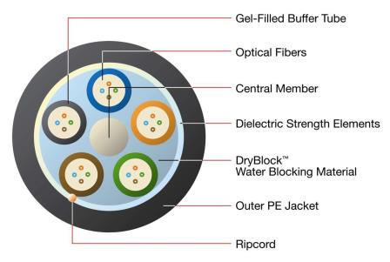
PowerGuide® TTH ADSS Cable
TTH - “To the Home”
Max fiber count, 30
6 fibers per tube – 2.0mm Tubes
Typical span lengths to 80 meters
Single jacket for drop type applications
Very inexpensive hardware

Slide 30
Mini LT Drop Cable
Flat drop
Typically uses Belden/PPC drop deadend
PLP has formed wire deadend
MRCL – 300 lbs

Slide 31
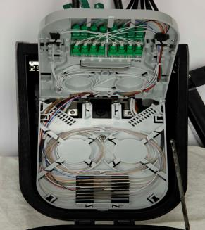
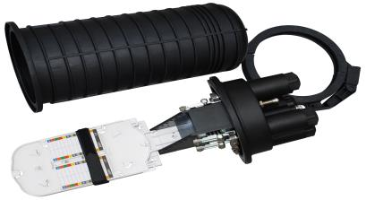
Terminals and closures
SlimBox Drop Terminal
Spliced or pre-connectorized drops
Holds splitters
Designed specifically for ADSS drop applications
Cost effective
Standard fiber optic closure
For longer span applications

Slide 32
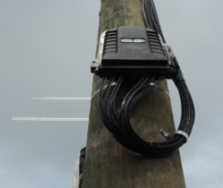
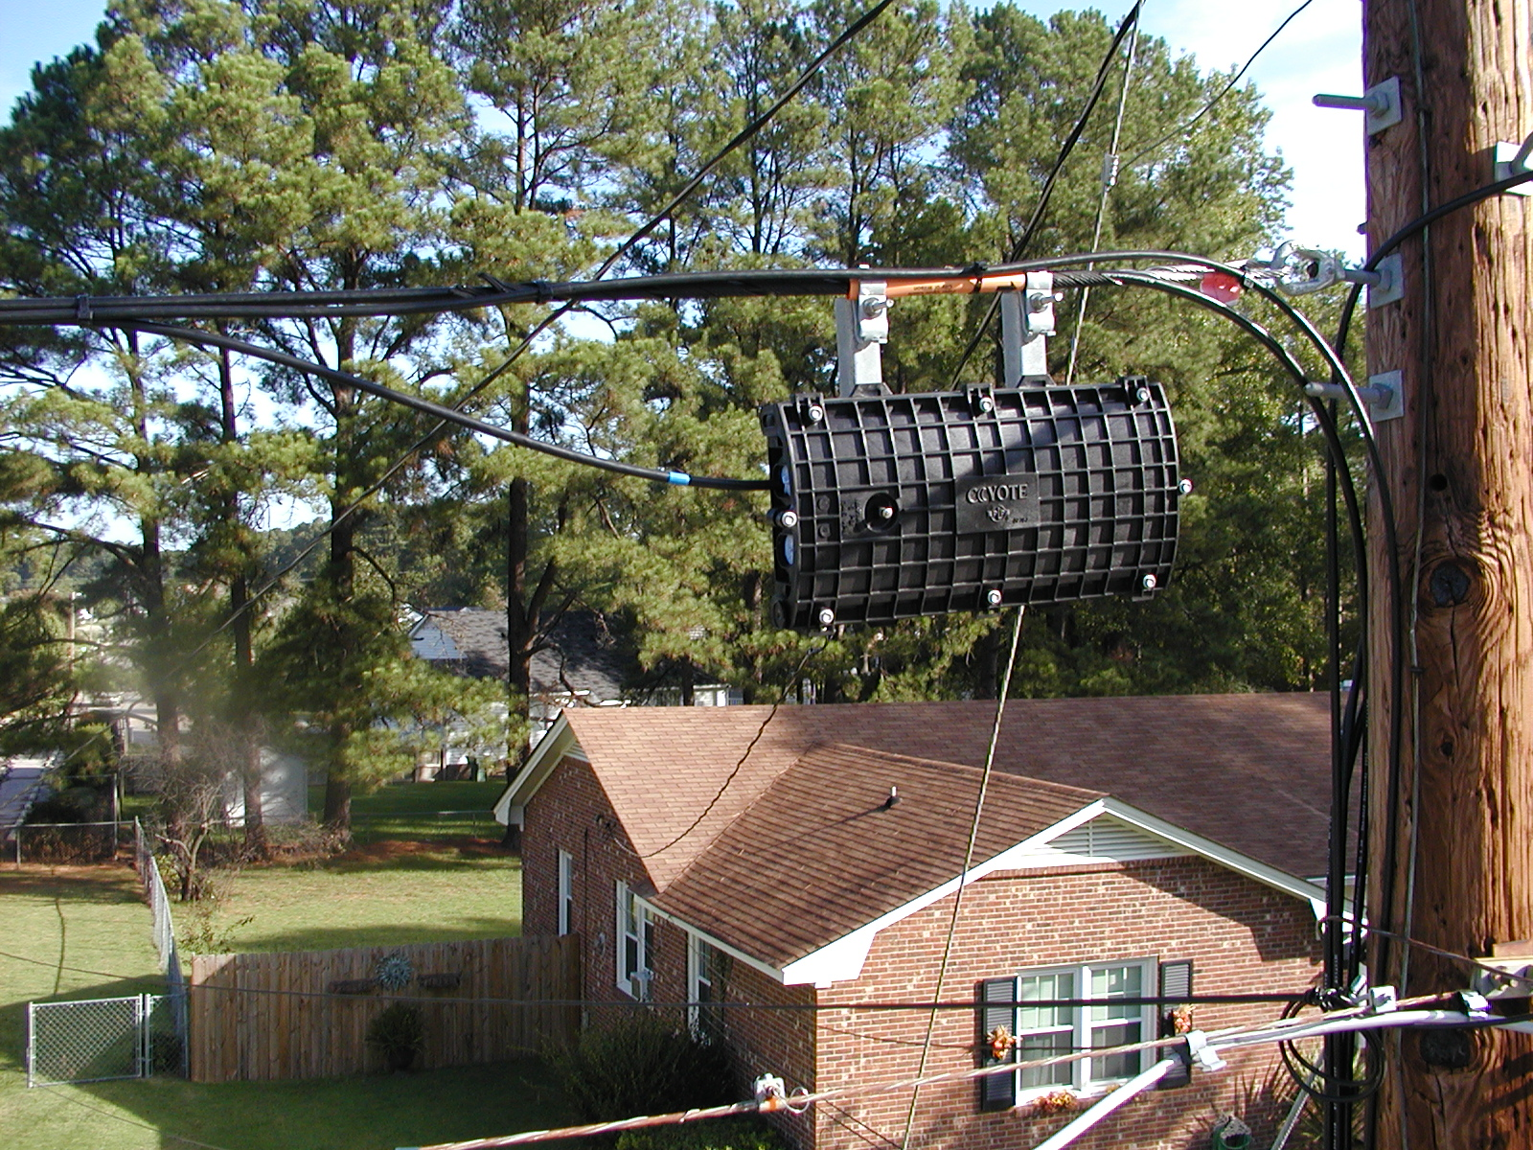
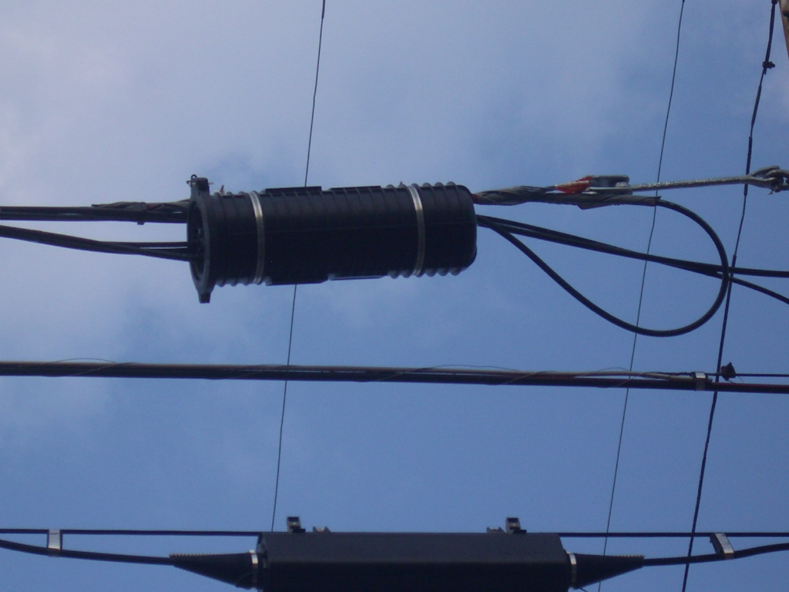
More ADSS terminal and closure detail
Common mounting methods
Pole mounting
Deadend mounting
If deadend mounting, formed wire hardware is typically used
OFS SlimBox Drop Terminal mounted on a pole
PLP closures attached to a deadend. Photos courtesy PLP

Slide 33
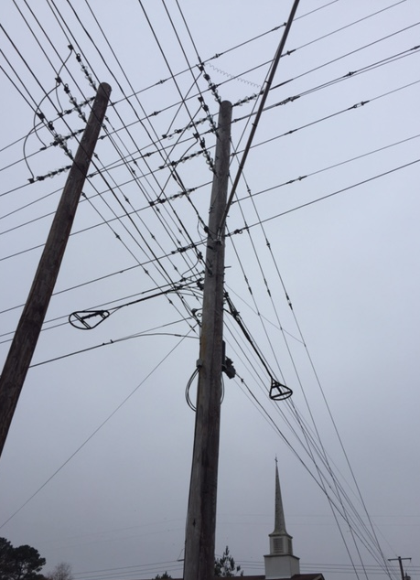
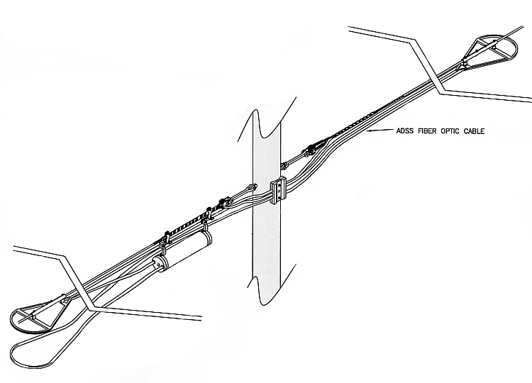
Splice and Slack Storage (Cable Mount)
ADSS snowshoes often used
Storage is done on either side of the pole (instead of in the span)
OFS provides a rule of thumb of 150’ per pole (37.5’ x 2, each side)

Slide 34
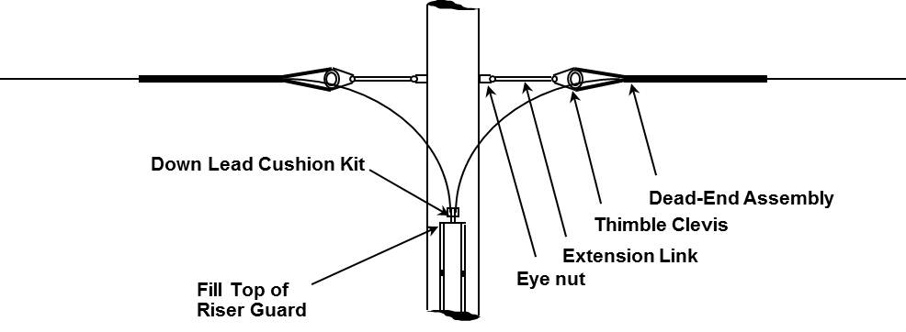
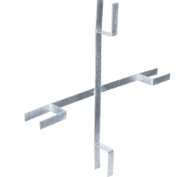
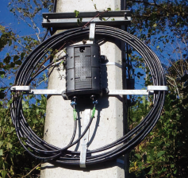
Splice and Cable Storage (Pole Mount)
24”
Minimum Dimension Requirements
30” - Height
24” - Width
12” - Depth
30”
Photo courtesy of Telenco

Slide 35
Splice and Cable Storage (Buried)
Leave Sufficient Cable
For Splicing Purposes

Slide 36
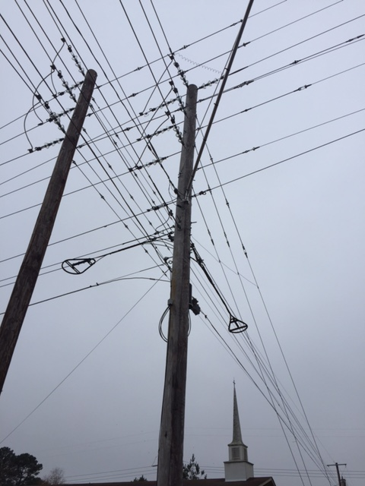
Managing multiple drops on a span
OFS recommendation is a separate pole attachment point for each drop
For aesthetic and/or make-ready concerns
Mini-LT flat drop may be tie-wrapped to the main ADSS cable at undefined intervals.
Not completely risk free
Contact OFS to discuss
OFS white paper, “Using ADSS cable in distribution applications - Storage and cable drop management” available for guidance

Slide 37
Summary
The main purpose of the cable is to protect the fiber
Using appropriate fiber and managing strain is critical to long term performance
Loose tube duct and ADSS cables are designed for different applications
OFS expects similar reliability
Many pros and cons to consider
Multiple ways of deploying cables
Weigh various factors when deploying
OFS can assist in assessing the best solution for the application

Slide 38
Questions?
Mark Boxer
Applications Engineering Manager
OFS
mboxer@ofsoptics.com
252 495-4131

